Slide 1
SHARE ASSISTANT
-DataScientists

Slide 2
IDEA
Zero UI - Zero UI refers to a paradigm where our movements, voice, glances, and even thoughts can all cause systems to respond to us through our environment.
Share Assistant - We plan to apply this concept to share trading, wherein the user can buy and sell shares and see the status of shares through the chatbot. Also, the user need not go to the payments page for it.

Slide 3
FLOWCHART
Wit.ai API for NLP
If authenticated
Share Assistant
Chatting
ChatBot using Gupshup
Buy/Sell
Face Recognition Module
View share info
Yes
No
If General share info?
General info
General
Barclays API is hit
Permission denied
Specific
Payment Completed OR View your shares
My shares

Slide 4
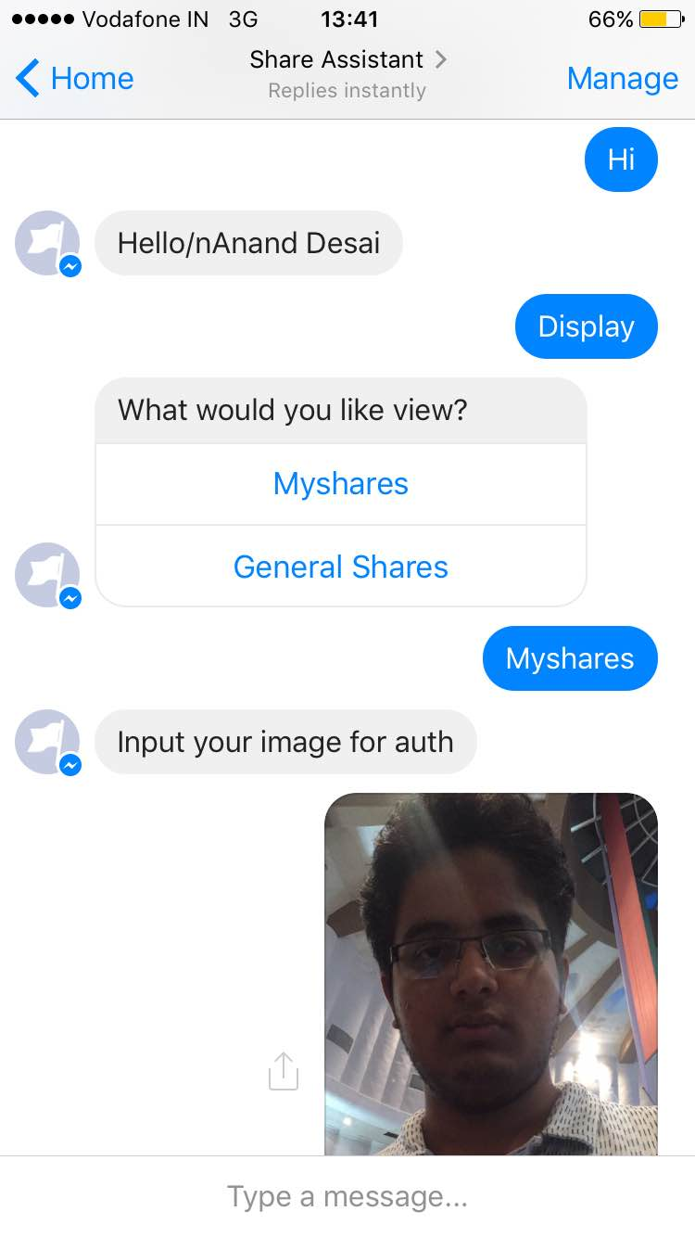
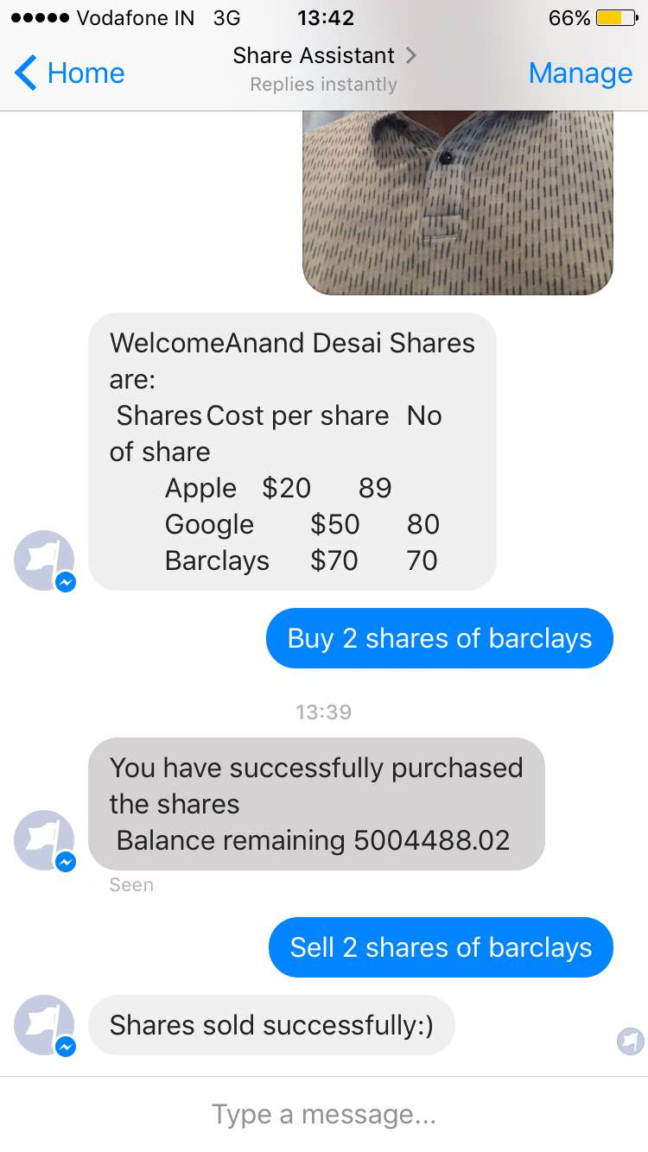
Screenshots

